Slide 1
LONGTERM INTERNSHIP
SMART INTERNZ
(FRONTEND DEVELOPMENT)

Slide 2
WEATHER APP

Slide 3
TEAM
TEAM ID : LTVIP2023TMID08015
COLLEGE: Vignan’s Institute of Engineering for Women,visakhapatnam.
TEAM SIZE: 4
TEAM LEADER: Dharmireddy Lahari
TEAM MEMBER: Gedela Hemadatta
TEAM MEMBER: Chukka Yamuna
TEAM MEMBER: Dasari Poornachandrika

Slide 4
PROJECT TOPIC
To create a Weather app using HTML,CSS, and Java script that provides real-time weather information for a specified location using the open weather app API key.
Users can search for a location by city name and receive detailed weather information, including temperature, humidity, wind speed, and weather conditions.

Slide 5
PROJECT OBJECTIVES:
The main objectives of this project is :
To create a user interface using HTML and CSS to display weather information.
To utilize JavaScript to interact with the Open Weather-Map API key and fetch weather data.
To update the UI with the fetched weather data dynamically.
To allow users to search for weather information by city name.

Slide 6
ABSTRACT
The Weather-app is a web application that provides real-time weather information for a specified location. It utilizes the Open Weather-Map API to fetch weather data and displays it in a user-friendly interface.
The Weather App is a simple project developed by using JavaScript, CSS, and HTML. The user can check the condition of the present-day climate probability and predict whether the day is a cloudy or sunny day.
Users can search for a location by city name and receive detailed weather information, including temperature, humidity, wind speed, and weather conditions.

Slide 7
BENEFITS OF WEATHER APP
When we input a name of a city ,we can easily see the current temperature, humidity, pressure and windspeed.
The weather app enables you make better preparation for the day in relation to giving accurate daily weather forecast.
The app provides you the details of the weather elements like pressure, temperature, windspeed.
This helps to track the details of your favorite cities and regions.

Slide 8
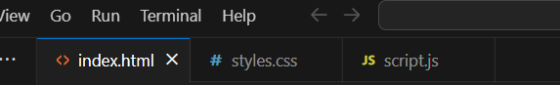
PROJECT STRUCTURE
Firstly create a new project folder for the Weather App.
index.html
style.css
script.js
After that set up the basic HTML structure.
Applying styles to the UI elements using CSS in style.css.
Design the layout and structure of the user interface using HTML elements and CSS classes.

Slide 9
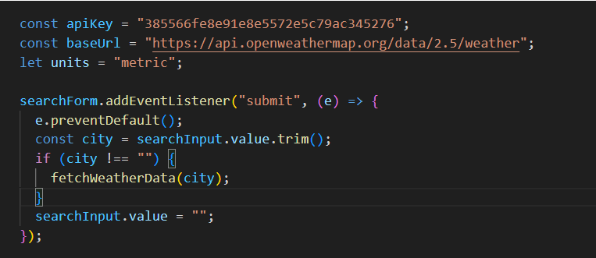
In script.js, define a constant variable to store your Open WeatherMap API key.
Using the Open WeatherMap API, we can get the necessary parameters.
Call the API key in java script.
API key
We added an input field and a button to the UI to allow users to enter a city name or zip code.
added event listener to the button to trigger the weather data fetch function when clicked.
After that we retrieved the user input from the input field.

Slide 10
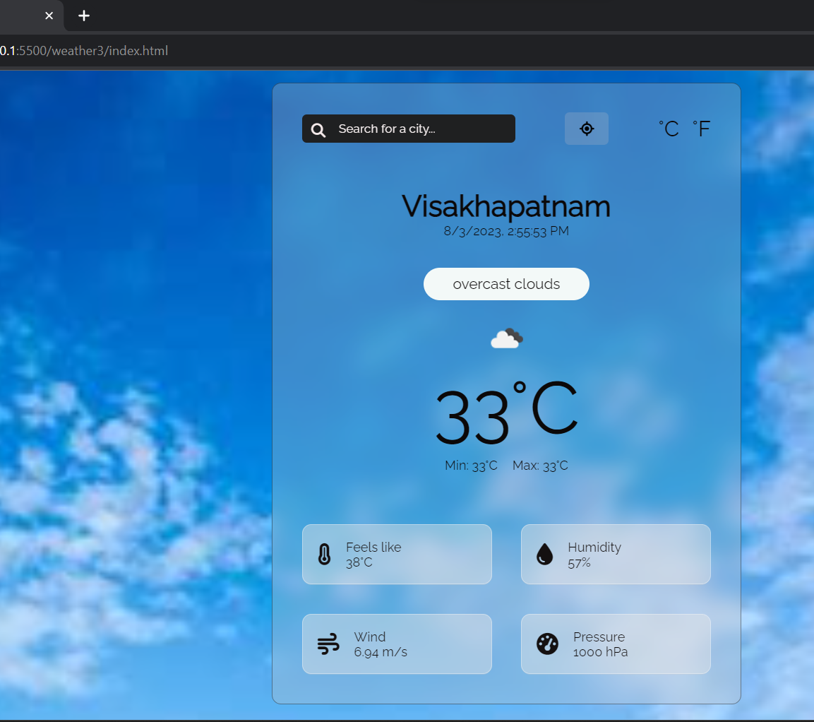
OUTPUT we can the get the output in a webpage.

Slide 11
CONCLUSION
We are created a Web page using the HTML,CSS, Java script and using the API key.
Finally we can get the required Weather details of a particular city which we are giving as a user input in that particular web page.
The data obtained by this can be seen in the web page with the weather details of particular city like temperature, windspeed, humidity.
This can be very helpful in our daily life application.

Slide 12
THANK YOU

